Slide 1
Unreal Game

Slide 2
Game description:
First Person 3D open world game built in Unreal Engine 4
What is Unreal Engine 4?

Slide 3
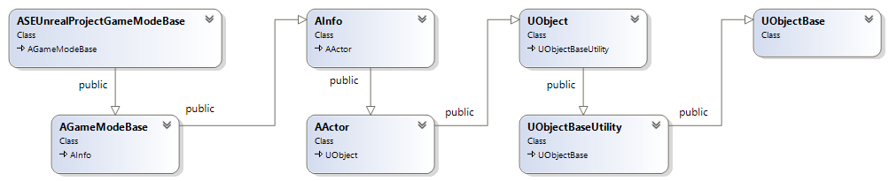
Talk is cheap show me the diagrams:
Class diagram:

Slide 4
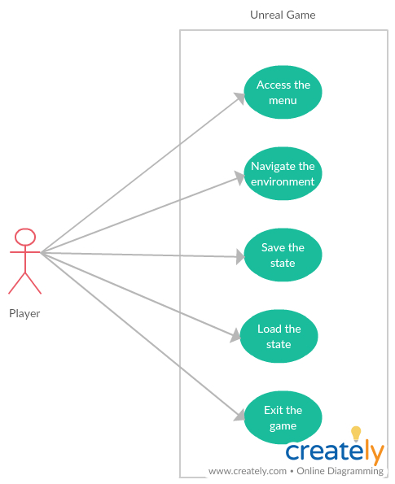
Use case diagram:

Slide 5
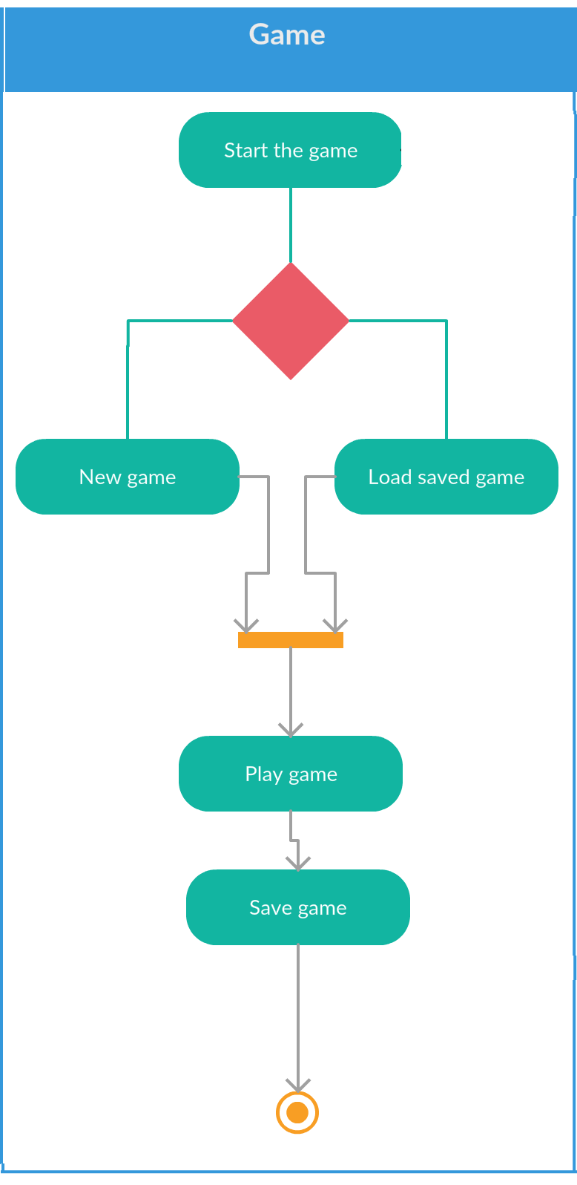
Activity diagram:

Slide 6
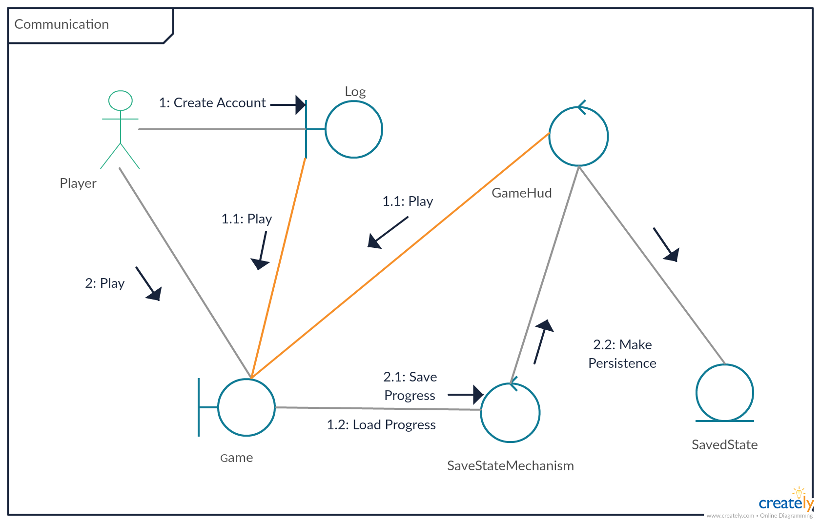
Communication diagram:

Slide 7
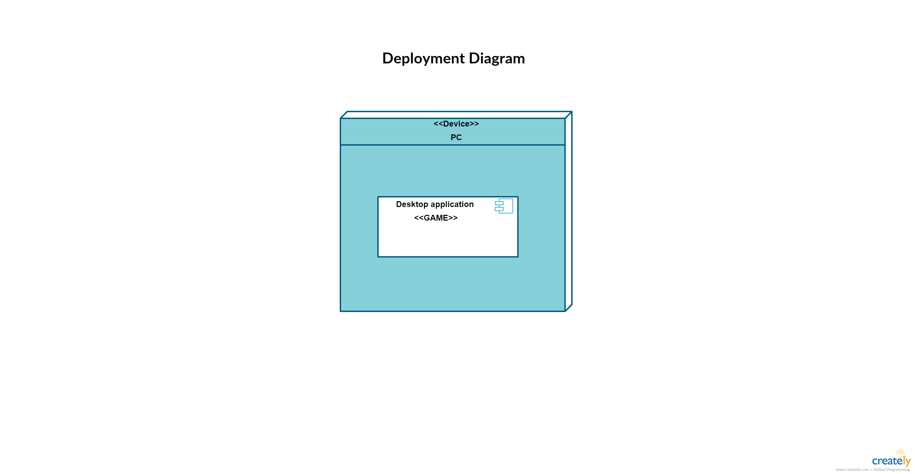
Deployment diagram:

Slide 8
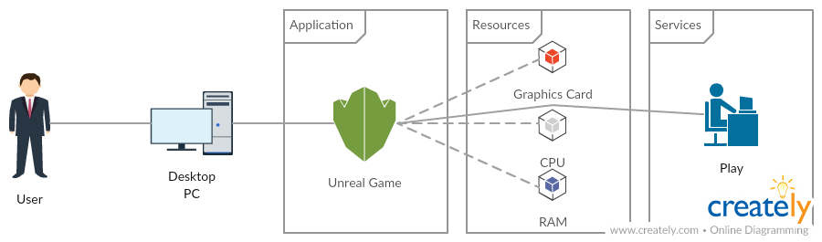
General System Architecture diagram:

Slide 9
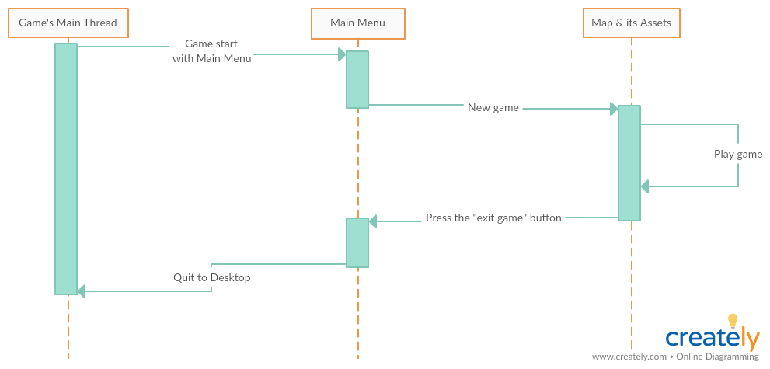
Sequence diagram:

Slide 10
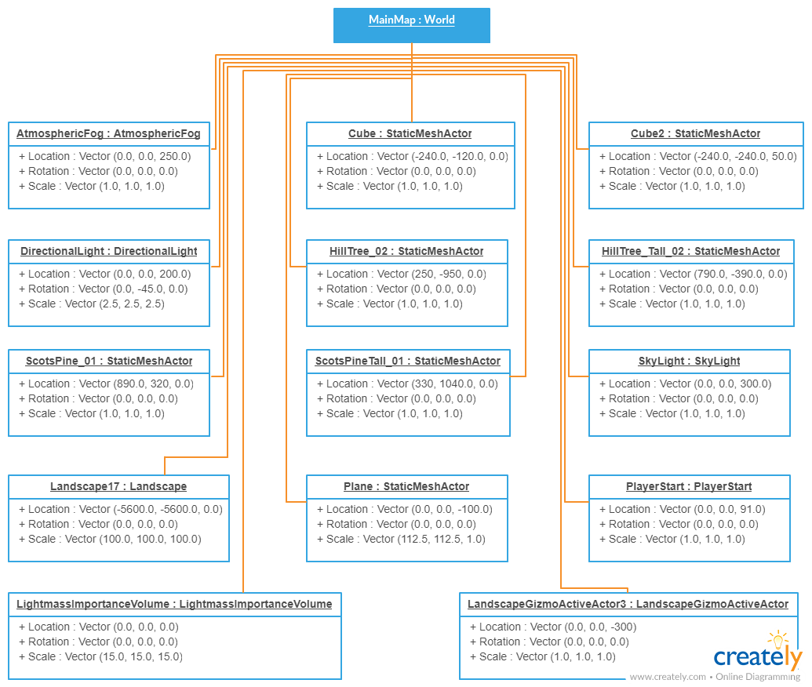
Object diagram:

Slide 11
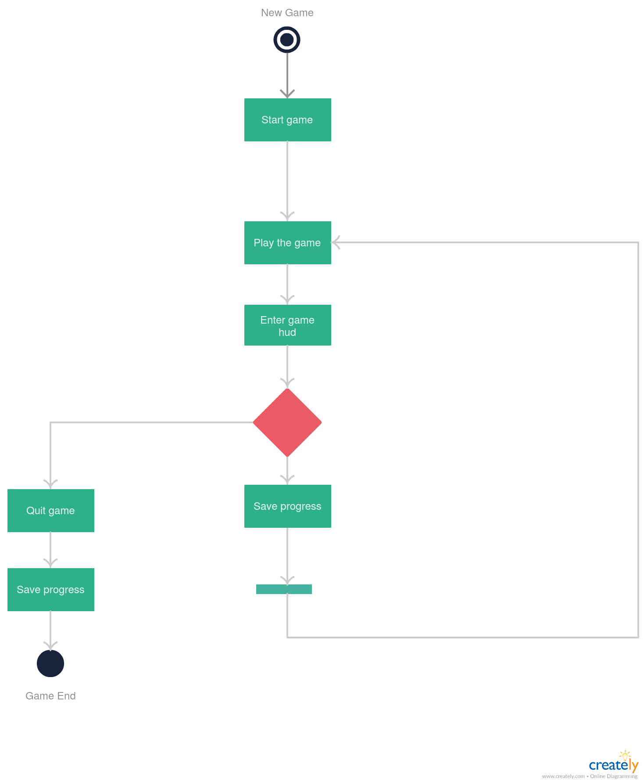
State diagram:

Slide 12
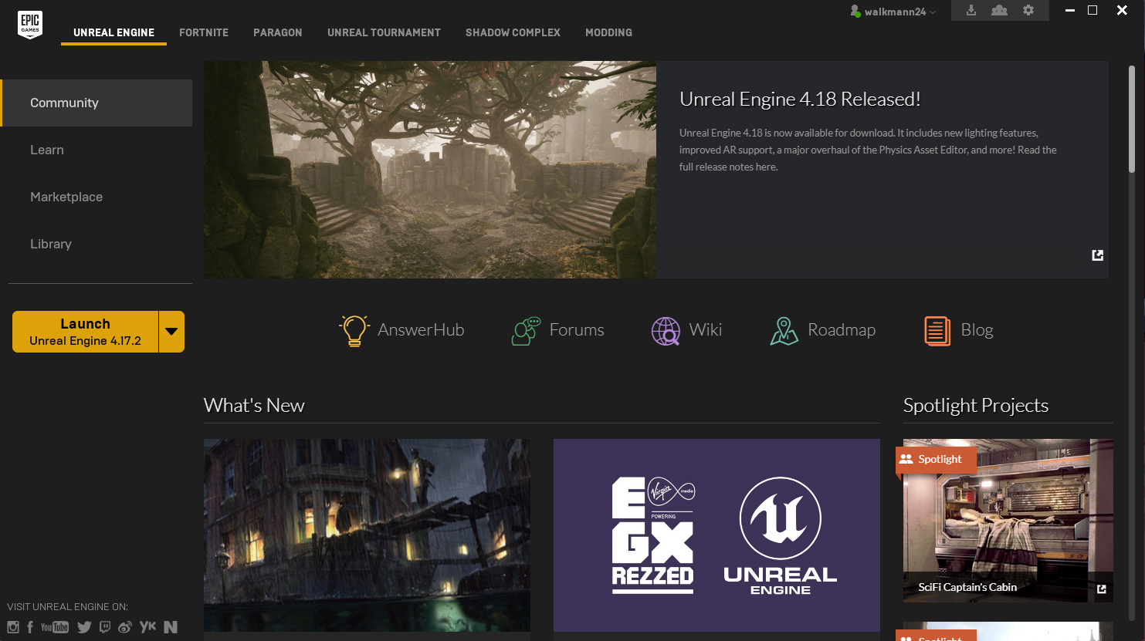
How does the environment look like?

Slide 13
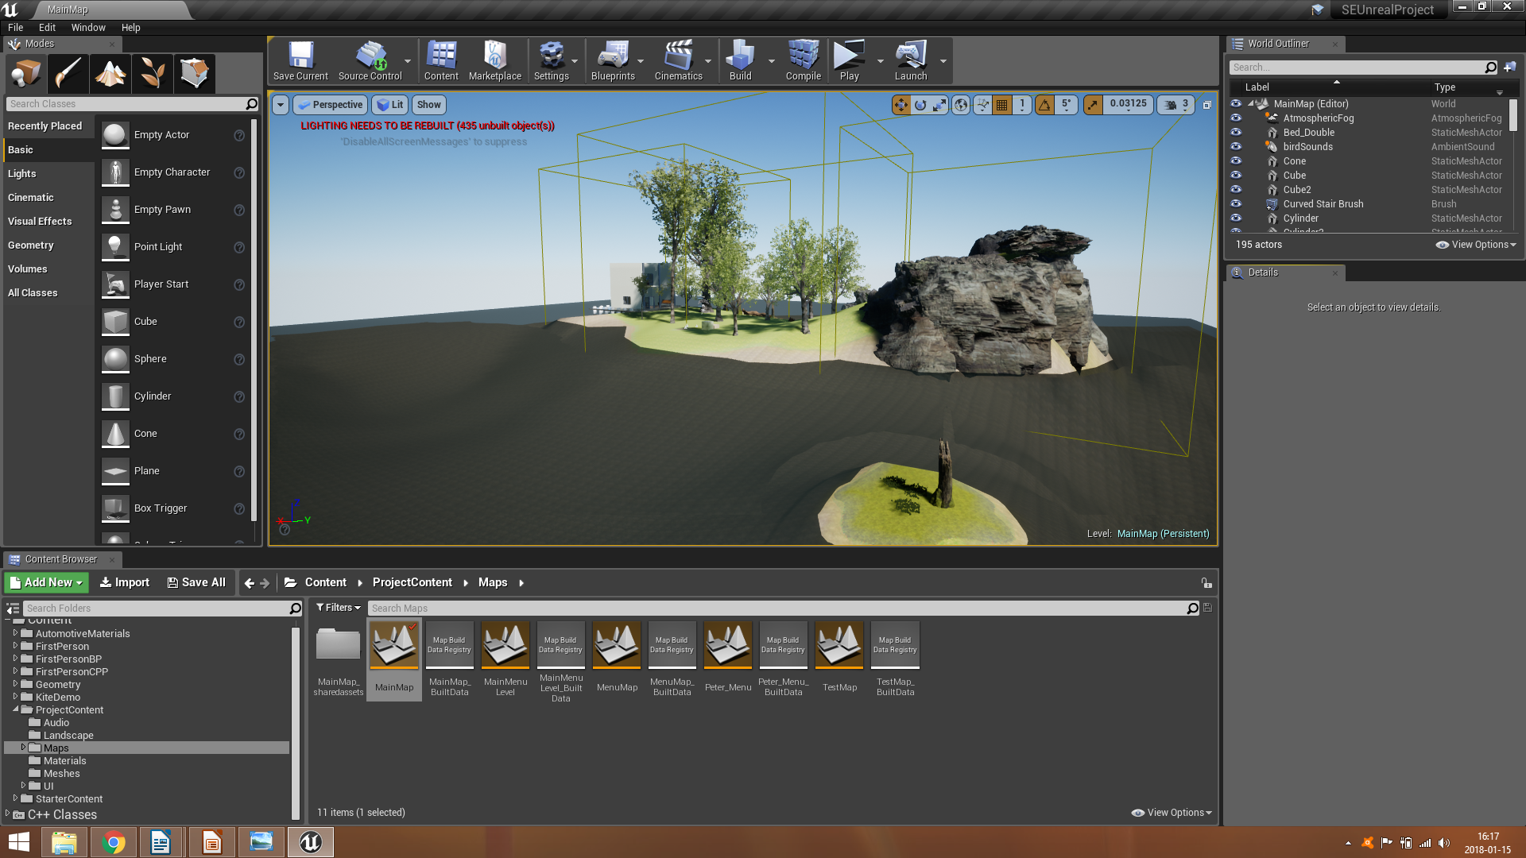
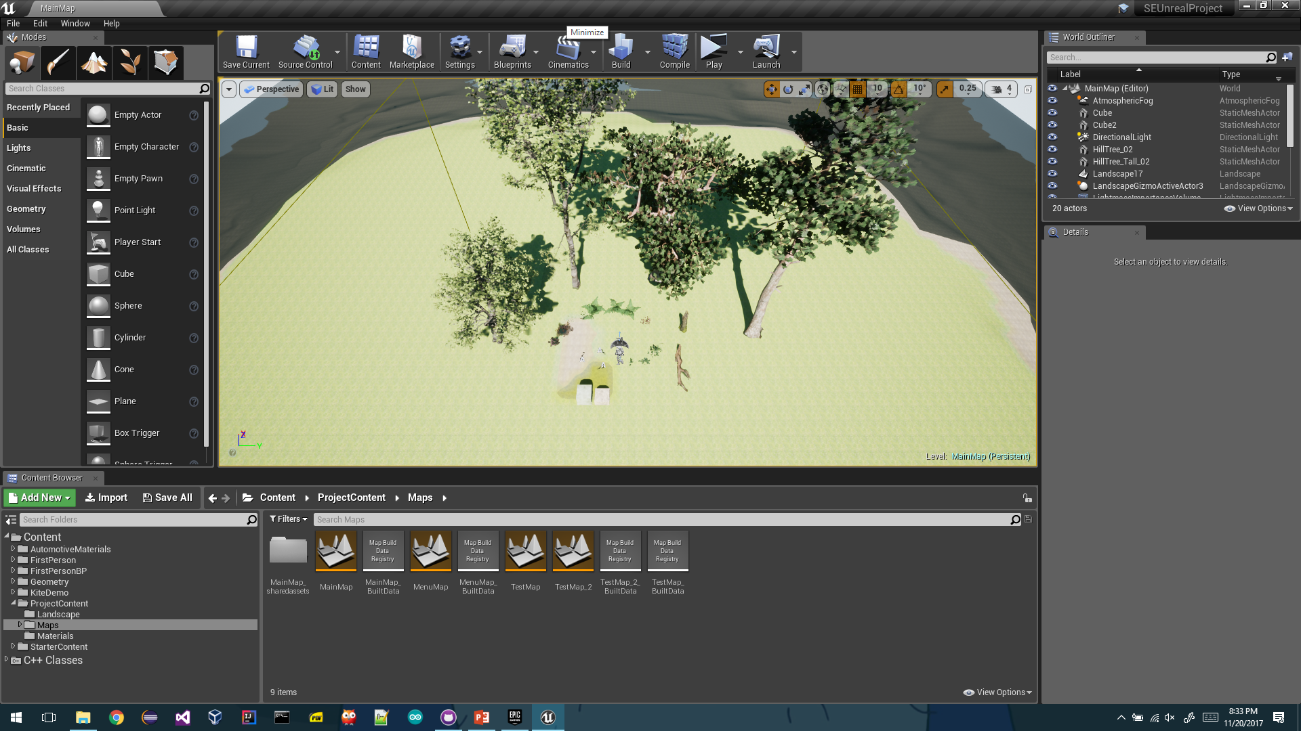

Slide 14
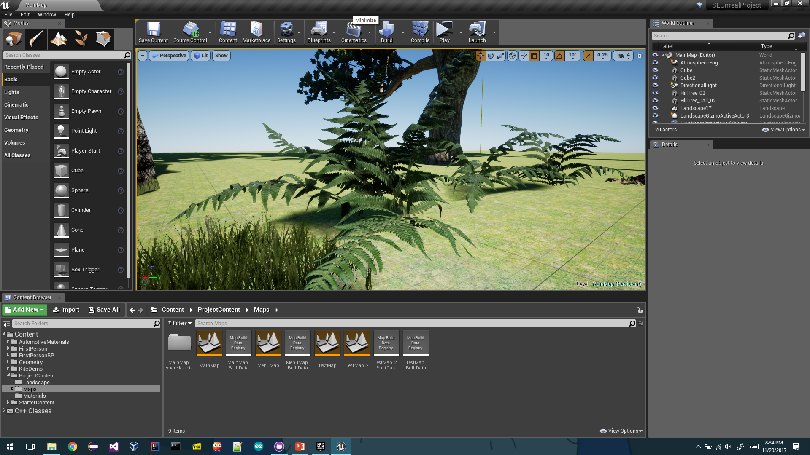

Slide 15
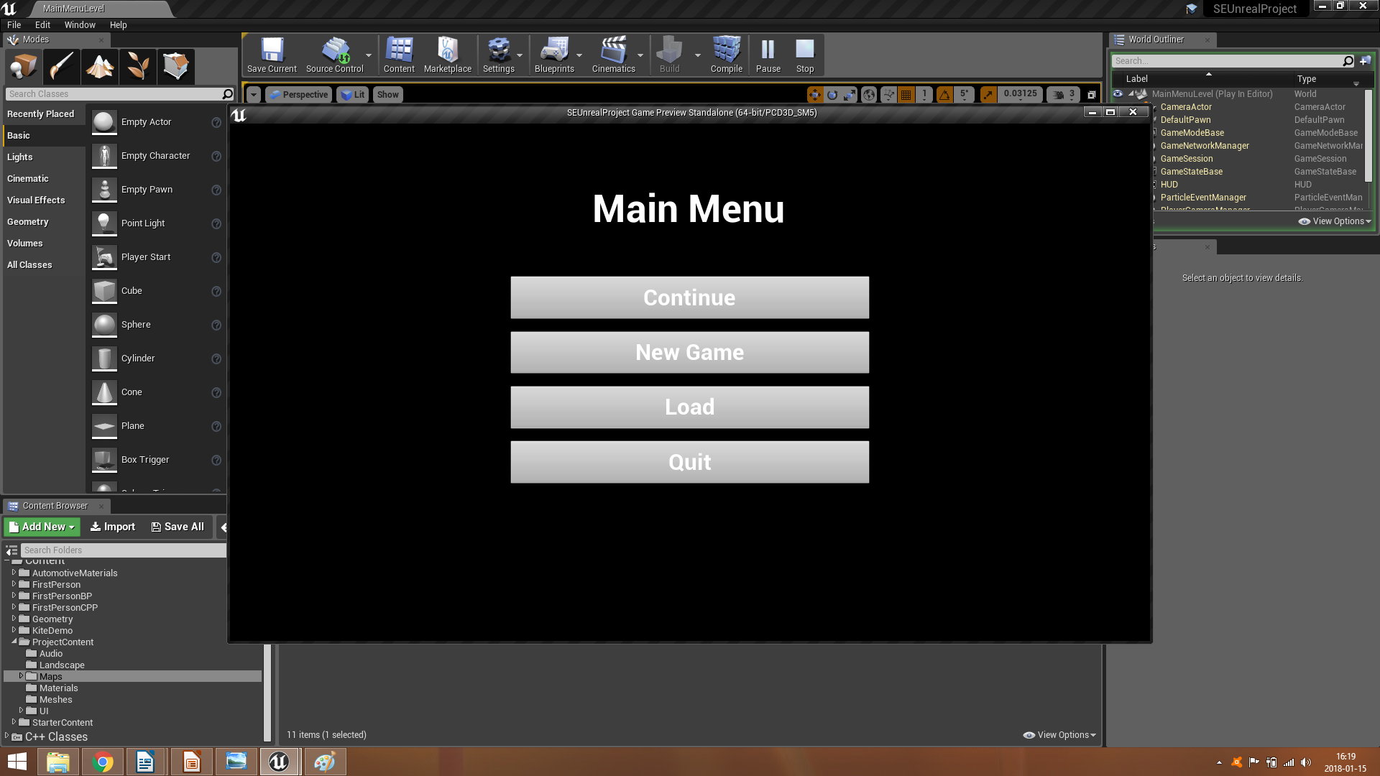

Slide 16
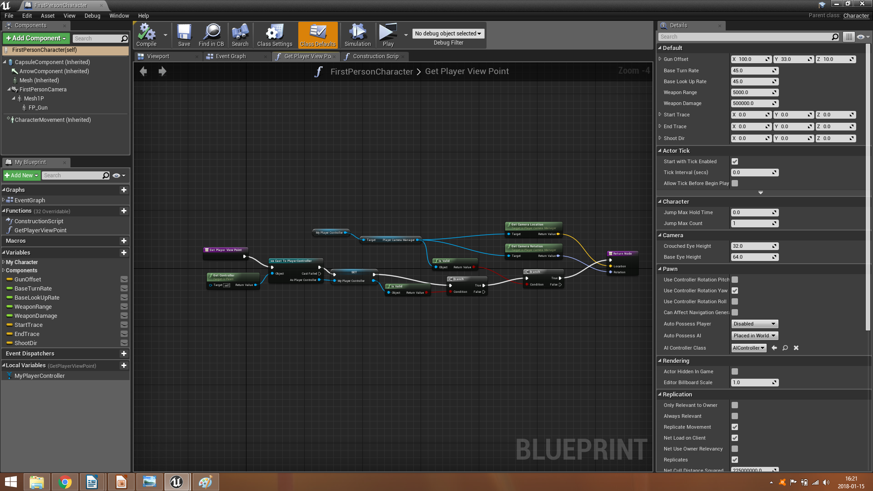

Slide 17
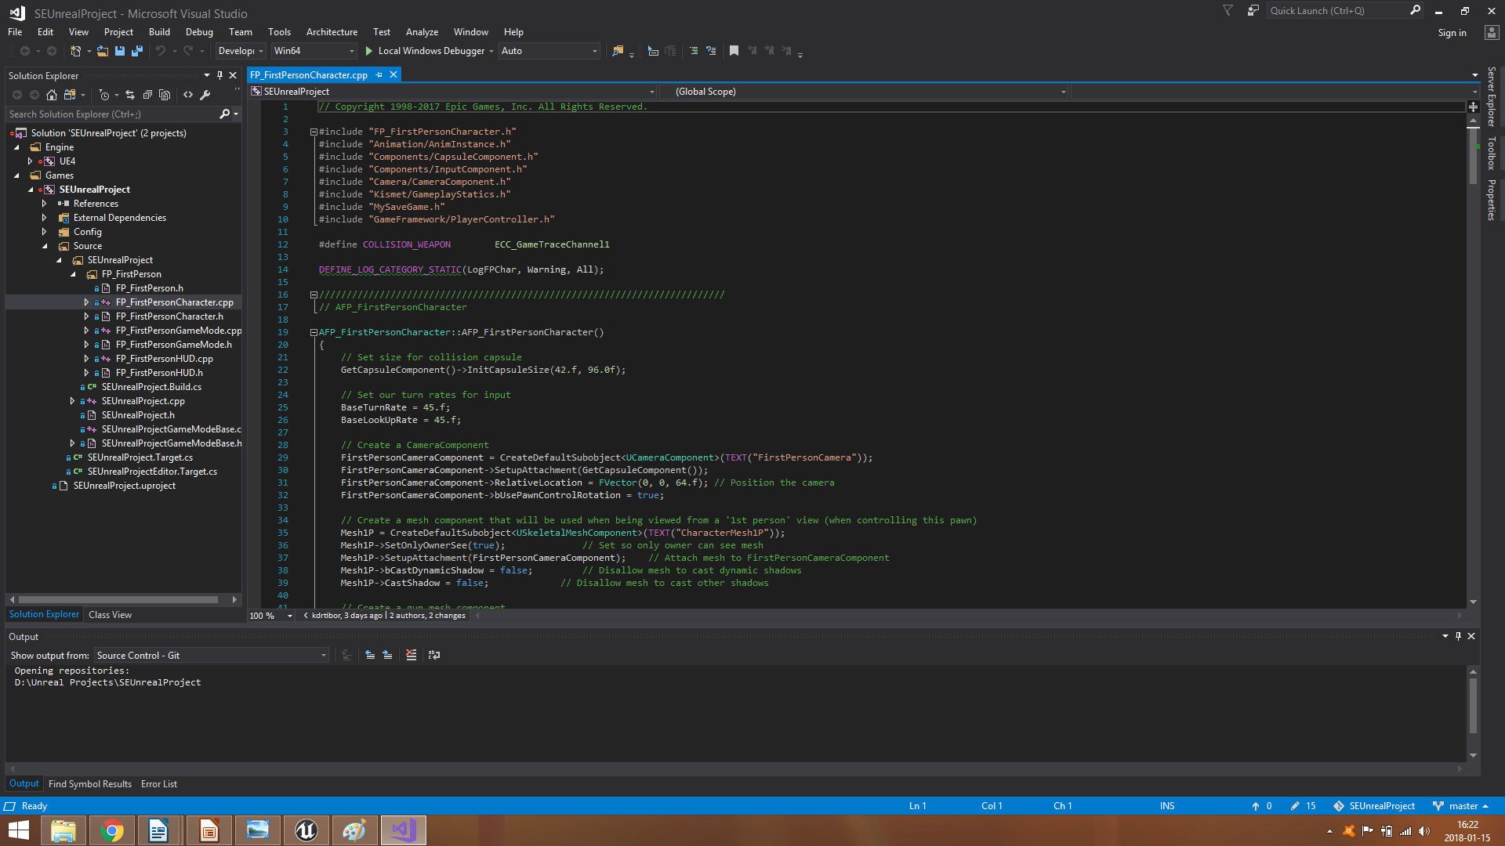

Slide 18
Thank you for your time
Developers:
Zavaczki Peter Tibor
Kadar Tibor Manasse

